Slide 1
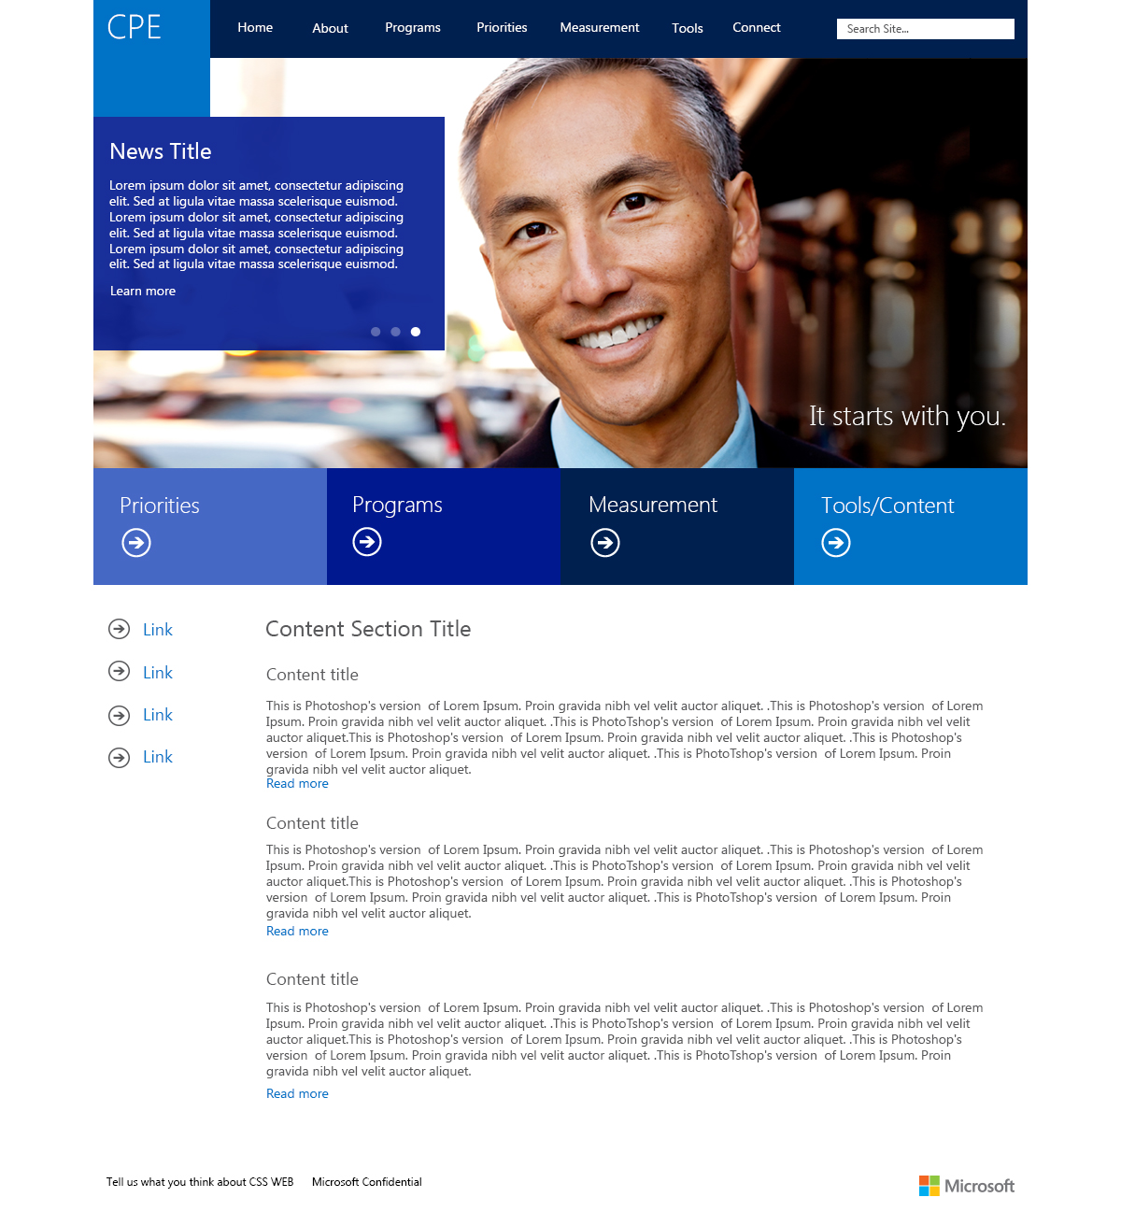
Microsoft CPE Website Design
The Challenge
Pending
What We Did
Pending
Results
Pending

